Slide 1
Database Management System

Slide 2
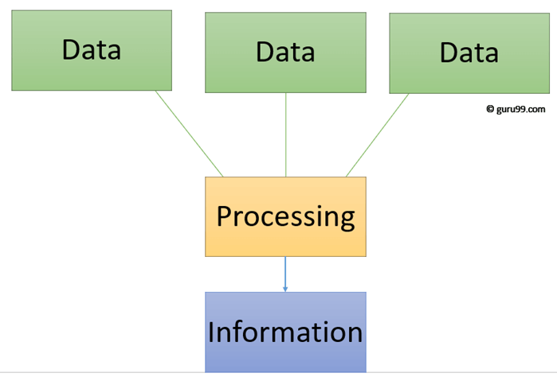
M-1: Introducing to Data & Data Management
Data - Data is a collection of facts & figures that can be processed to produce information.
Information - Information is data that has been processed in such a way as to be meaningful to the person who receives it. it is any thing that is communicated.

Slide 3
Database - Database is a collection of co-related data Or in other words the database is a collection of inter – related data which is used to retrieve, insert and delete the data efficiently. It is also used to organize the data in the form of table, schema, views and reports etc.
DBMS – A database management system stores data in such a way that it becomes easier to retrieve, manipulate and produce information.
Components of Database System – There are 4 components of database management system.
Data
Hardware
Software
Users
Goal of DBMS – The goal of a DBMS is to provide an environment, that is both convenient & efficient to use in –
Retrieving information from the database
Storing information into the database

Slide 4
NOTES – Databases are usually designed to manage large bodies of information. This involves –
Definition of structures for information storage (data modeling).
Provisions of mechanisms for manipulation of information (file and systems structure, query processing).
Providing for the safely of information in the database (crash recovery & security).
Concurrency control if the system is shared by users.
Some Other Definitions –
Data Definition – It is used for creation, modification and removal of definitions that defines the organization data in the database.
Data Updation – It is used for insertion, modification and deletion of the actual data in the database.
Data Retrieval – It is used to retrieve the data from the database which can be used by the applications for various purpose.
Data Administrator – It is used for registering and monitoring users, maintain data integrity, enforcing data security, dealing with concurrency control, monitoring performance and recovering information corrupted by unexpected failure.

Slide 5
Characteristics of DBMS –
It uses a digital repository established on a server to store and manage the information.
It can provide a clear and logical view of process to manipulate data.
DBMS contains automatic backup and recovery procedure.
It contains ACID properties, to maintain data.
It can reduce complex relations between data.
It is used to support manipulation and processing of data.
It is used to provide security of data.
Advantages –
Controls database redundancy.
Data sharing
Easily maintenance
Reduce time
Backup
Multiple user interface
Disadvantages –
Cost of Hardware & Software
Size
Complexity
Higher impact of failure

Slide 6
File-based System and Database Management System
DBMS is a collection of data. In DBMS, the user is not required to write the procedures.
DBMS gives an abstract view of data that hides the details.
DBMS provides a crash recovery mechanism, i.e., DBMS protects the user from the system failure.
DBMS provides a good protection mechanism.
DBMS contains a wide variety of sophisticated techniques to store and retrieve the data.
DBMS takes care of Concurrent access of data using some form of locking.
File system is a collection of data. In this system, the user has to write the procedures for managing the database.
File system provides the detail of the data representation and storage of data.
File system doesn't have a crash mechanism, i.e., if the system crashes while entering some data, then the content of the file will lost.
It is very difficult to protect a file under the file system.
File system can't efficiently store and retrieve the data.
In the File system, concurrent access has many problems like redirecting the file while other deleting some information or updating some information.

Slide 7
Some specific Definitions -
File –
A file is a collection of bytes stored as an individual entity. All data on disk is stored as a file with an assigned file name that is unique within the directory it resides in.
To the computer, a file is nothing more than a series of bytes.
The structure of a file is known to the software that manipulates it.
A file contains data that is needed for information processing. These data is about entities.
Entity – An entity is anything about which information can be stored.
Attribute – An attribute is a characteristic of interest about an entity. The values of the attributes describe a particular entity.
Instance – An instance of the entity is represented by a set of specific values for each of the attributes.
Data Item – Each attribute of an entity is represented in storage by a data item.

Slide 8
Some specific Definitions -
Record – A data item is the elementary unit in data storage. Data items are usually grouped together to describe an entity. The data representation in storage of each instance of an entity is commonly called as a record. A collection of related records is called a file.
Note – In the file – processing environment, the emphasis is on files and the relationship among them. The different types of files are –
Master Files – This is a file of relatively permanent information about entities. These files are used as a source of reference data for processing transactions and accumulated information based on the transaction data.
Transaction Files – This is a collection of records describing activities or transactions by organization. It is created as a result of processing transactions and preparing transaction documents. Transaction files are also used to update the details in the master file.
Report Files -

